Slide 1
Modernizing Applications with Containers

Slide 3

Day 1 Module 1: Introduction to Containers Module 2: Assessing the App and Environment for Containers Module 3: Building and Testing a Container Locally Day 2 Module 4: Preparing for AKS Deployment Day 3 Module 5: Deploying the Application to AKS Module 6: Best Practices and Tips
Agenda

Slide 4
Module 3: Building and Testing a Container Locally

Slide 5
Module 3: Objectives
Learn Docker Fundamentals (Docker Engine and Client)
Understand Container Images and Docker Registry
Learn How to Build Container Image using Dockerfile
Learn how to Start, Stop, and Remove Docker Containers
Understand use of Tags for Versioning Images

Slide 6
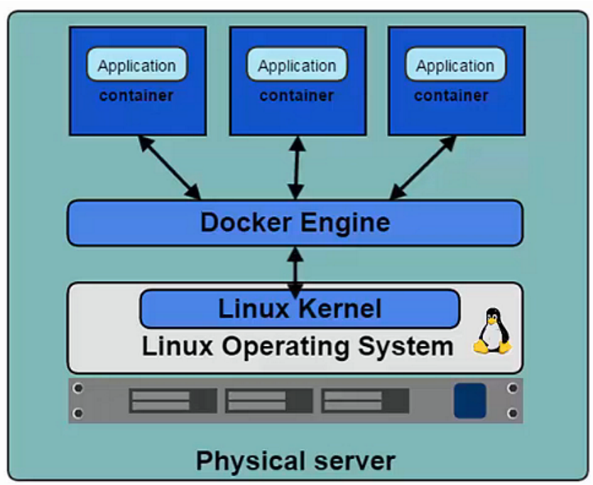
Docker Platform
Docker Engine (a.k.a. Docker Daemon)
The program that enables containers to be built, shipped, and run.
Uses Linux Kernel namespaces and control groups to give an isolated runtime environment for each application
Docker Hub
A online registry of Docker images
Docker Trusted Registry
Private on-site Registry for Docker images
Notes:
Let’s describe Docker platform:
Docker => industry standard
Engine ⬄ Daemon => runtime to run & manage container.
=> interact with the Linux Kernel
But you Cannot containerize everything -> example: usage of kernel related features (Windows registries).
Initially based on Linux OS with OS specific components (namespace, control group for isolation) => release in Dec 2013
Docker Hub => store your images online
Docker trusted registry => implement Docker Hub on premises

Slide 7
Docker Platform (Cont.)
Docker Client
Takes user inputs and sends them to the Daemon.
Client and Daemon can run on the same host or on different hosts.
Docker Images
Read-only template used to create containers.
Contains a set of instructions for creating the containers.
Docker Containers
Isolated application platform based on one or more images.
Contains everything needed to run your application.
Host
Container 1
Container 2
Docker Client
Container 3
docker push
docker pull
Container …
docker run
docker …
Docker Daemon
Notes:
Docker client => CLI -> commands to interact with the daemon
Docker Images => definition of your container => list dependencies, how to install / them set them up.
Docker container => image instance. Snapshot of your image available to be run.

Slide 8
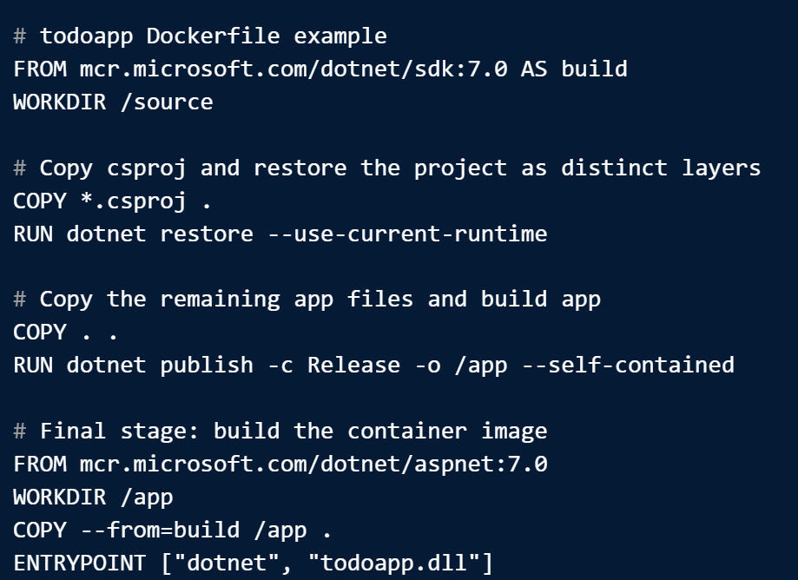


Steps for Containerizing an Application
Step 1: Create a Dockerfile
Step 2: Build the container image and push to a registry
Step 3: Run the container using the image

Slide 9
Module 3: Demonstration
Build Docker Image
Run Docker Image Locally

Slide 10
Module 3: Lab #1
Build BioGuide Docker Image
Run BioGuide Docker Image Locally

